Slide 1
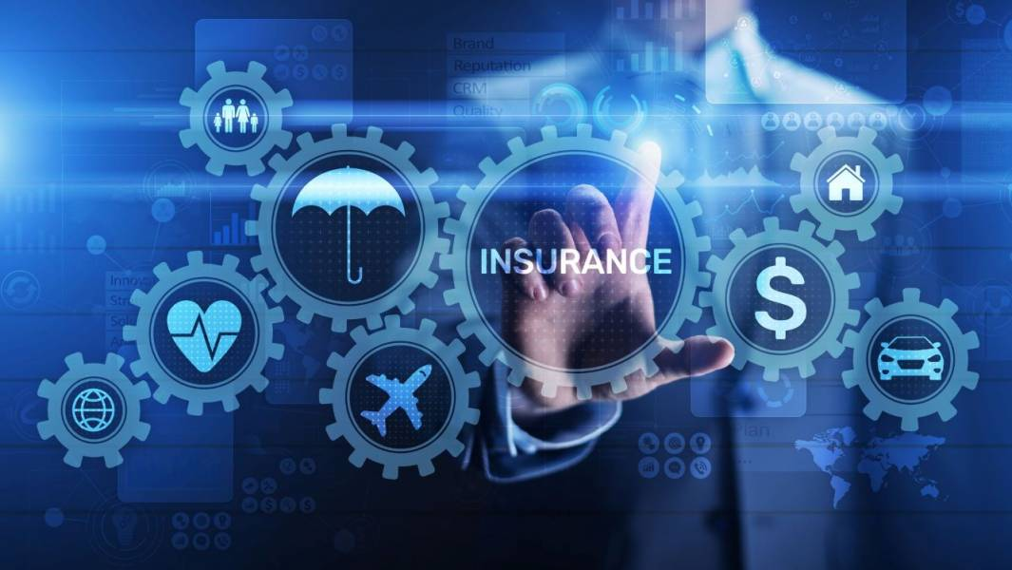
AI-Powered Intelligent Insurance Risk Assessment and Customer Insights System By Kannan Sakthi B THANKS TO GUVI

Slide 2
Problem Statement :
Insurance companies face challenges in assessing risk, predicting claim amounts,
Detecting fraudulent claims, and understanding customer sentiments. Traditional
Methods rely heavily on manual evaluation, leading to inefficiencies and biased
Decision-making. With the advancement of AI and machine learning, automated risk
Assessment and customer analysis can improve efficiency, accuracy, and customer experience.

Slide 3
Steps To Solve:
INSURANCE RISK PREDICTION
INSURANCE AMOUNT PREDICTION
CUSTOMER SEGMENTATION
CUSTOMER CLAIM FRAUD PREDICTION
MULTILINGUAL LANGUAGE TRANSLATOR
CUSTOMER FEEDBACK CHATBOT

Slide 4
AI features :
DEVELOP AN TRANSLATOR FOR MULTIPLE LANGUAGES
DEVELOP CHAT BOT FOR CUSTOMER FEEDBACK
WORD CLOUD FROM SENTIMENT ANALYSIS

Slide 5
Insurance Risk Prediction
For risk score prediction we taken dataset consists of the Age Claim History
Annual-Income Claim-Amount Fraud label Policy-Type and related data
Based on the data and pattern the model finds some customers would be more
High Risk and Medium Risk and low Risk
And we train the model using Random Forest Classifier
And we achieve the accuracy of 0.91 and 0.93 %

Slide 6
Insurance Amount Prediction
For Insurance Amount prediction we taken dataset consists of the Age Claim History
Annual-Income Risk-Score Fraud label Policy-Type and related data
Based on the data and pattern the model finds for some customers would
Have low risk so we give insurance and high risk no insurance
And we train the model using Random Forest Regressor
And we achieve the accuracy of 0.98

Slide 7
Customer Segmentation
First when we have the raw data without any target and labels
We want to cluster the data and find out the pattern
In this data we have a raw data of Age Annual-Income Policy Upgrades
Claim Frequency Policy –count and total premium Amount paid
Based on the data we cluster it and find out the labels called
Young professionals ,High Risk Customers ,Low Risk Customers
And we use k means Clustering and prediction we use random Forest classifier

Slide 8
Customer Claim Fraud Prediction
We want to find the claim if fraud or not fraud we take the dataset consists of
Claim-Amount Claim-type Suspicious-Flags
Claim-type may be many varieties like Auto medical Life
Based on that our model trained and predicted which customer is fraud and not
And we used the logistic Regression for this model
And find out Zero means not fraud and One means fraud

Slide 9
Multilingual language terms
Different countries speak different languages and use different languages
Based on that we developed the Translator for globalization
For our terms and conditions and the people will understand very easy
And we use the hugging face model for the translator

Slide 10
Customer Feedback Chat Bot
Different Customers have different suggestions and different perspectives
On the Insurance some may like and some one may not like
And we want Analyze and we want to enhance it
we use Sentiment Analysis for to identity the feedback
The feedback is Positive or Neutral or Negative
The Positive feedback are also we want to accept it
And the negative feedback are also we want to accept and enhance it

Slide 11
Tools And Technologies
Apps And Cloud :
Notebook, Py Charm , Co-lab
Libraries :
Pandas, Seaborn , Scikit learn ,matplotlib ,regex ,translator
References :
Refer the Teachings ,google and ,Ai tools

